Slide 1
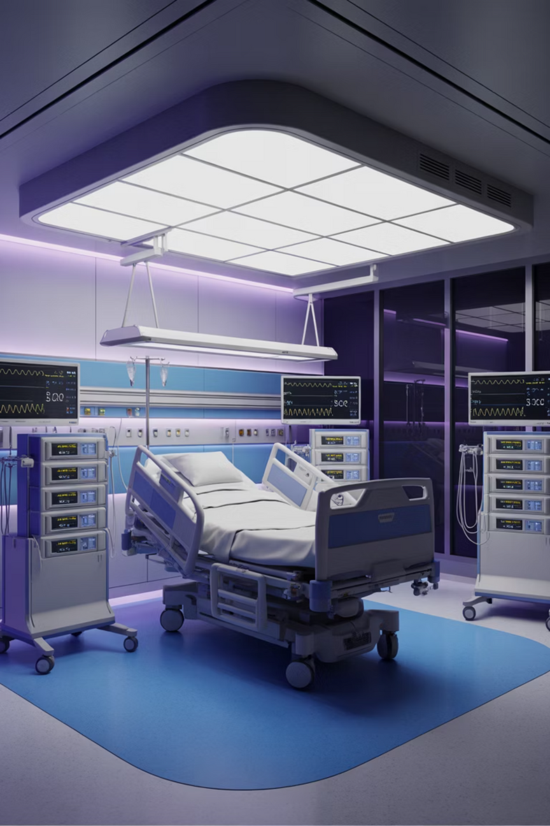
Prediction of AKI in ICU using MIMIC-IV: From Phenotyping to Drug Attribution
Presented by TEAM 7
A comprehensive clinical research project investigating adverse drug events and acute kidney injury in critically ill patients using machine learning and electronic health record data.
Notes:
Hello everyone, we’re Team 7 and our project focuses on predicting drug-induced Acute Kidney Injury in ICU patients using the MIMIC-IV dataset. We built a fully reproducible SQL-based pipeline and machine learning models to better detect AKI risk early.”

Slide 2




The Challenge of Drug-Induced AKI in the ICU
Reproducible Pipelines
Outcome Definitions
Class Imbalance
Many published models rely on ad-hoc preprocessing that is difficult to reproduce across institutions and datasets.
AKI definitions vary (SCr-only vs full KDIGO), and model features often ignore temporal context and progression.
AKI events attributed to specific drugs are rare, so metrics like ROC-AUC can look impressive even when precision and F1 are poor.
Notes:
In the ICU, AKI is mostly detected after kidney damage has already happened — a challenge commonly highlighted in prior studies. We also found from existing papers that many models rely on inconsistent AKI definitions and use pipelines that cannot be easily reproduced across hospitals. Drug-associated AKI is also a rare outcome, which means commonly reported metrics like ROC-AUC can appear strong even when models fail to identify true at-risk patients.
“We reviewed recent literature on reproducibility in kidney research, including an editorial in Kidney360 that focuses on the role of transparent, reproducible methods in nephrology research. We also examined a related study published in Frontiers in Medicine that highlights challenges and solutions in implementing rigorous, reproducible pipelines, insights from these led to our decision to build a fully clean, consistent way workflow for AKI detection.

Slide 3
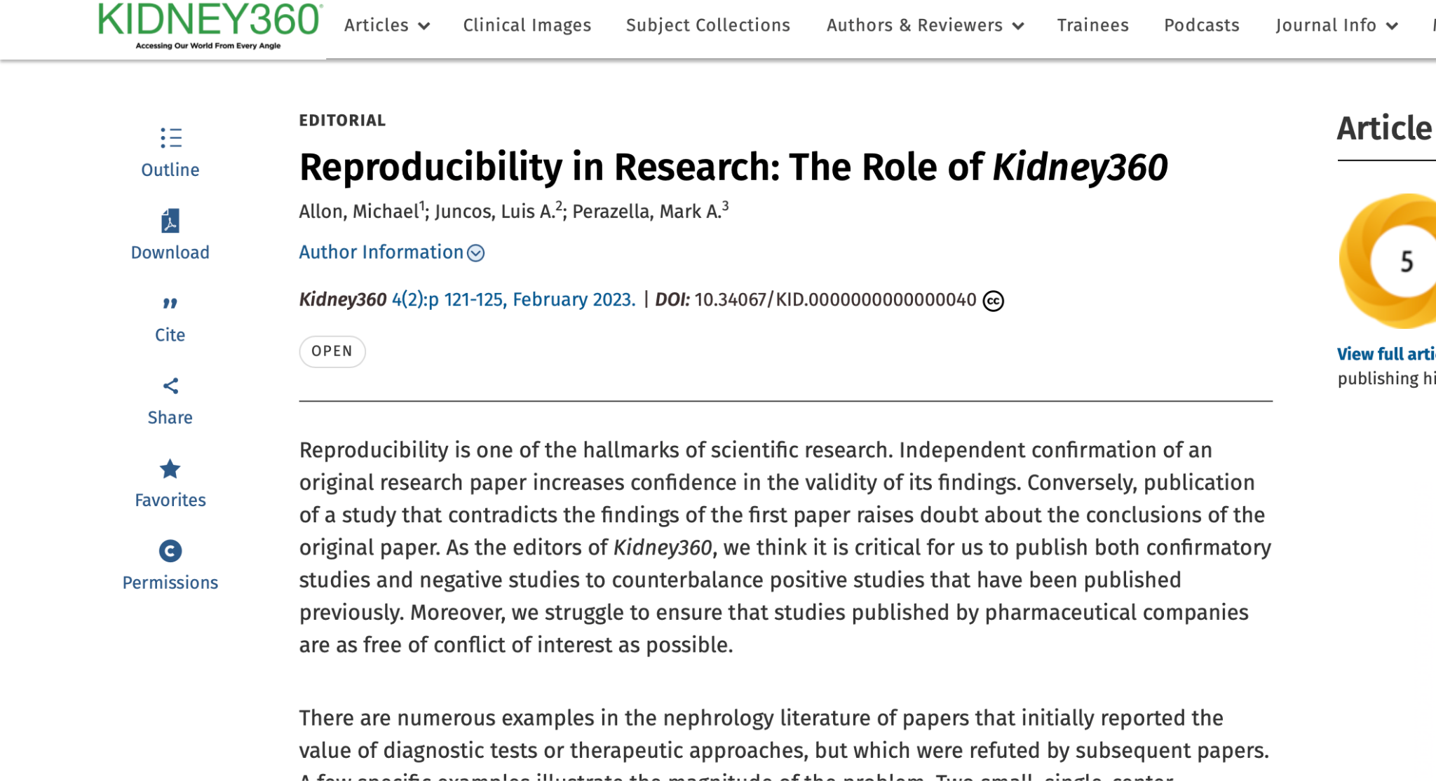
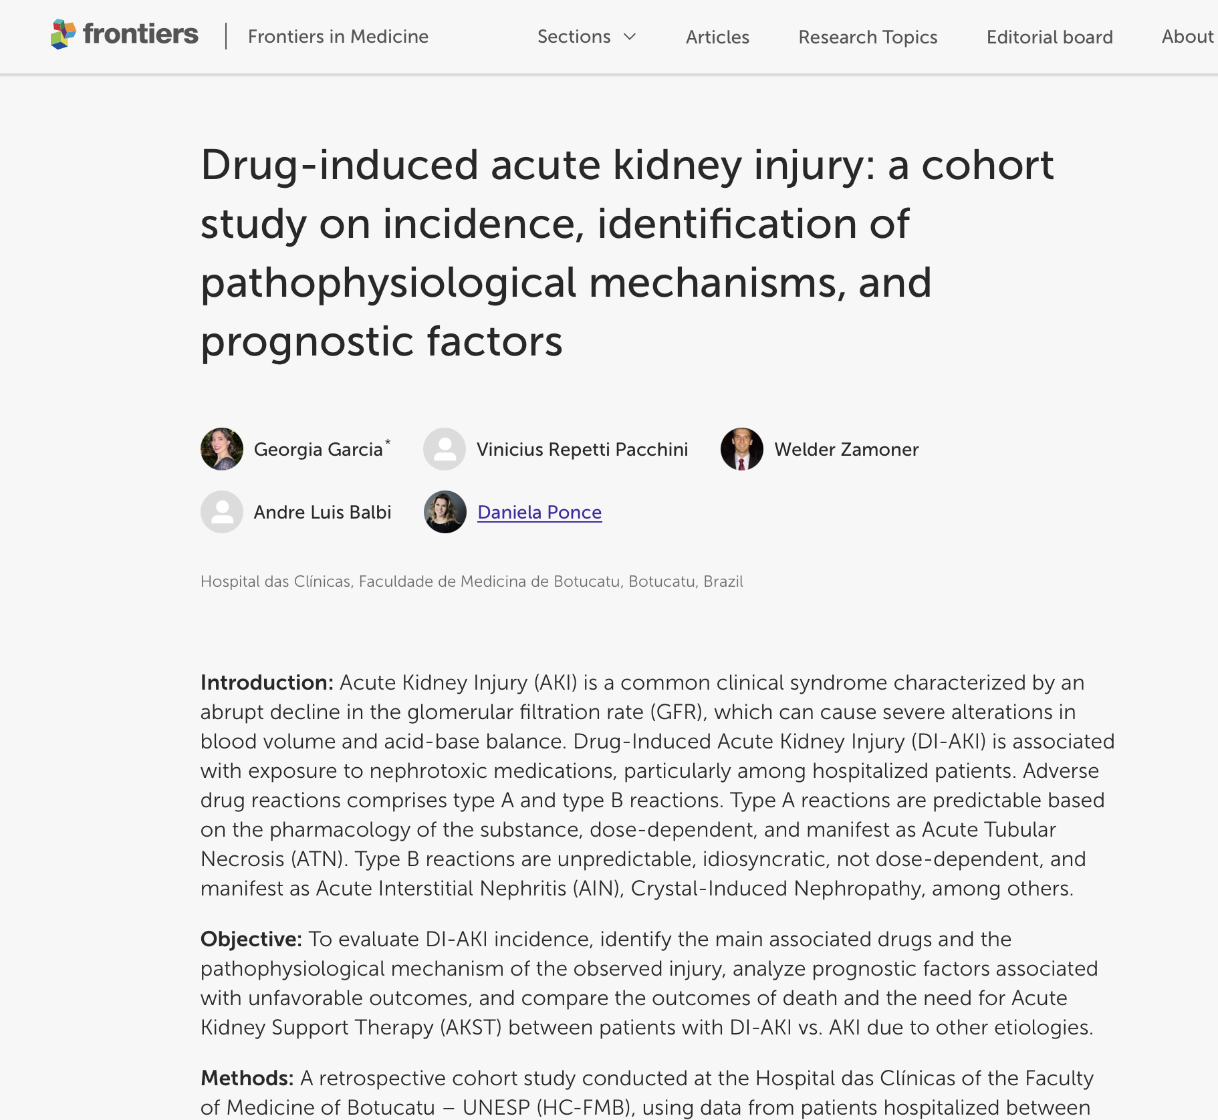
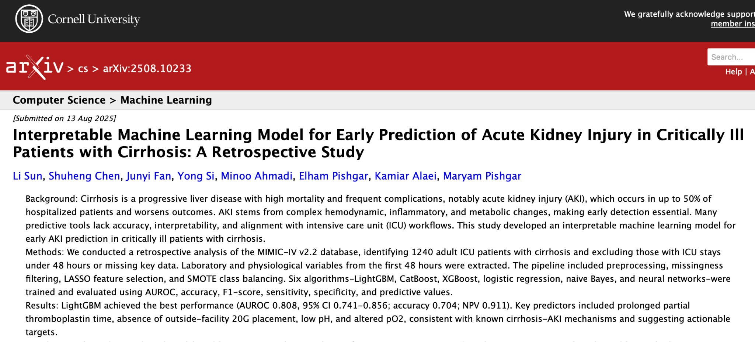
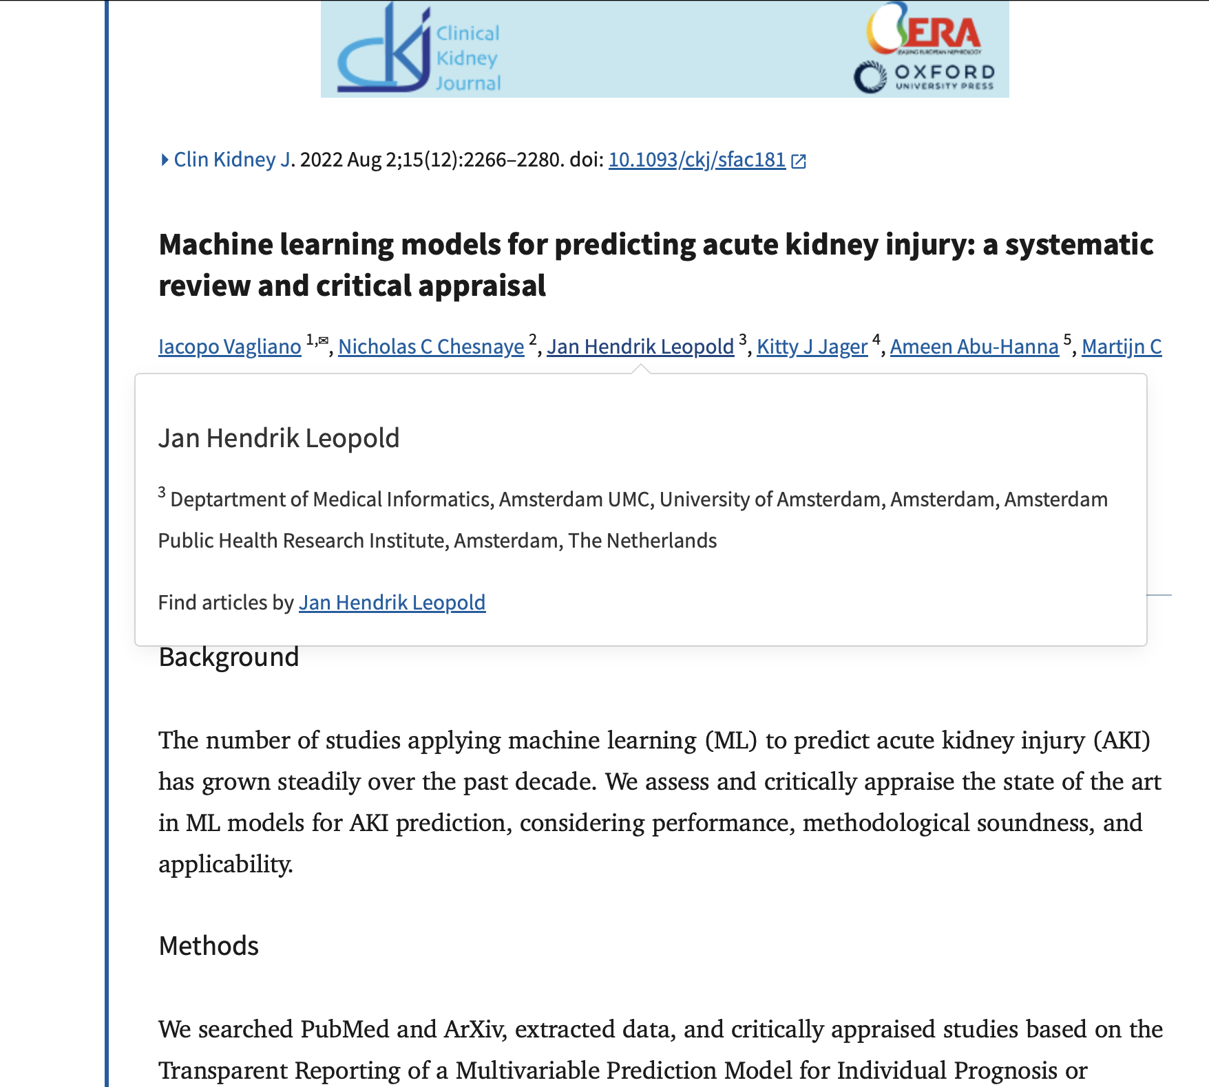
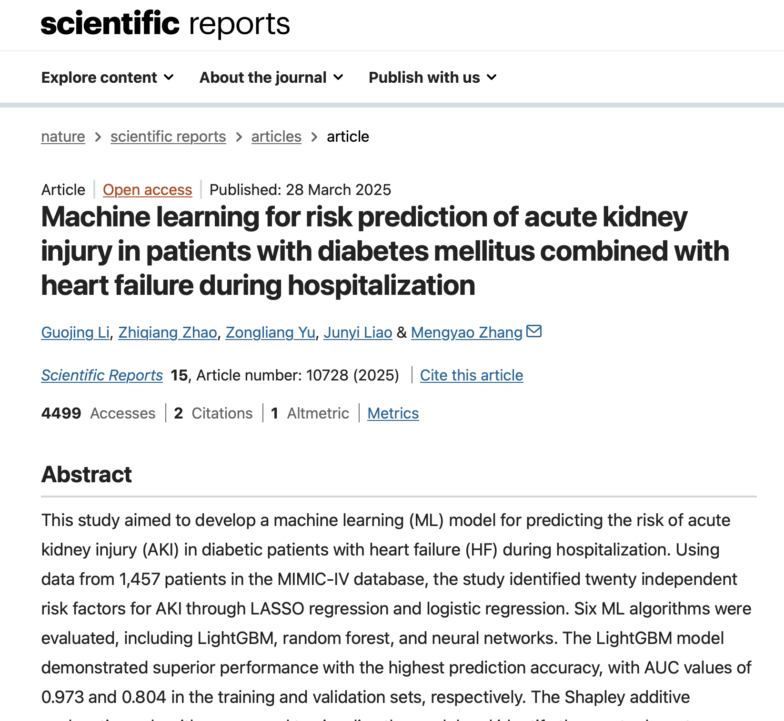

Slide 4
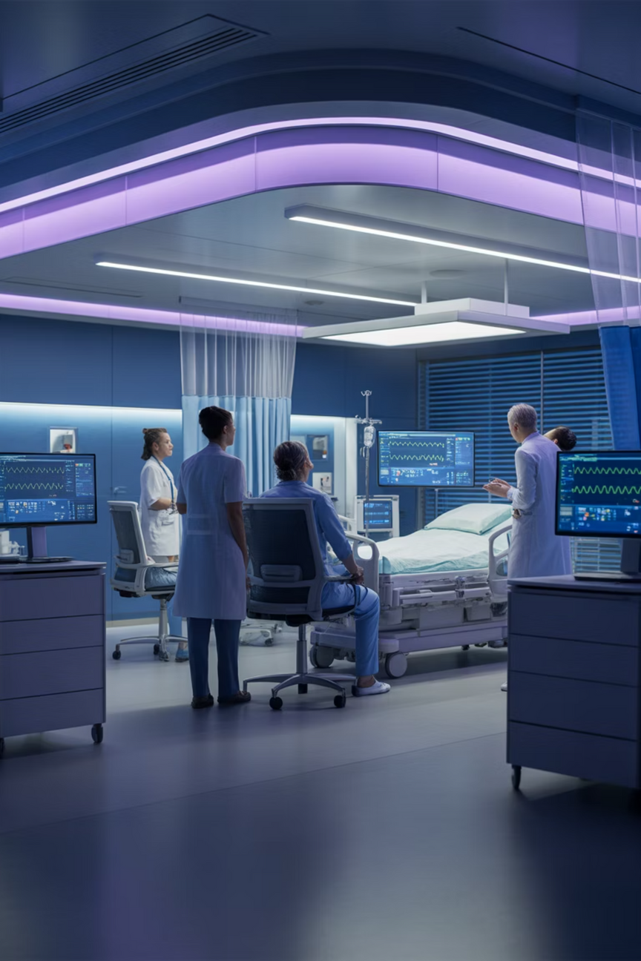
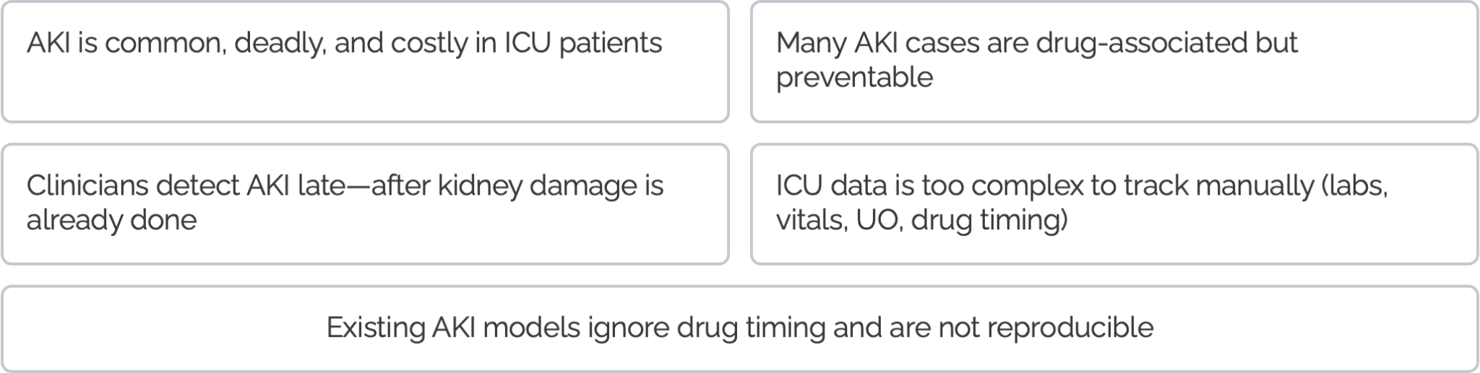
Clinical & Technical Motivation
Notes:
We did this bec a large portion of AKI is linked to medications — which means it can be prevented.
The challenge is that clinicians usually notice AKI only after creatinine rises, which means the kidney has already suffered damage.
ICU patients generate thousands of data points each day, but these trends are not manually trackable
Our goal was to use these time-based data to flag AKI risk earlier so clinicians can act before real harm happens.”

Slide 5
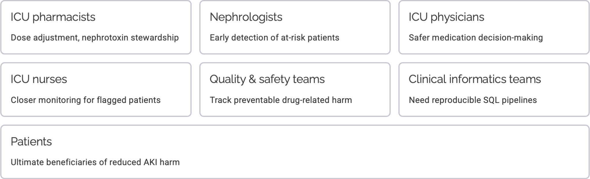
Who Benefits From This
Notes:
This approach helps everyone in the ICU:
Pharmacists adjusting doses,
Nephrologists monitoring high-risk patients,
ICU teams making safer decisions, and
Patients, who face fewer complications.

Slide 6
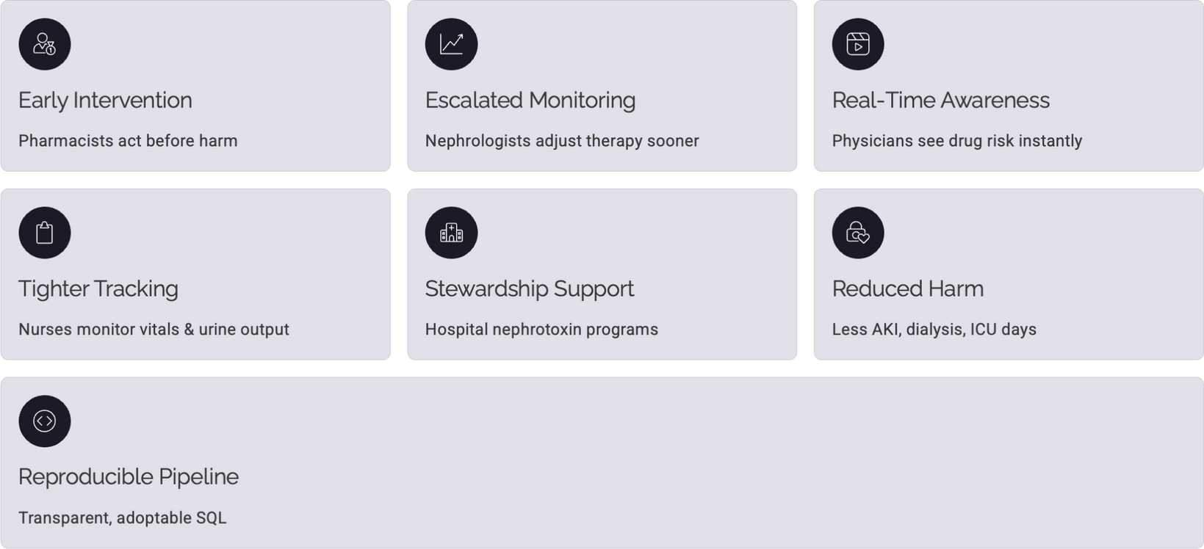
Impact of Our Model
Notes:
This also leads to:
fewer severe AKI cases,
fewer dialysis needs, and
shorter ICU stays,
Now that we’ve covered why this problem matters and the potential impact of our work, I’ll pass it on to talk about the key considerations that shaped our solution.

Slide 7
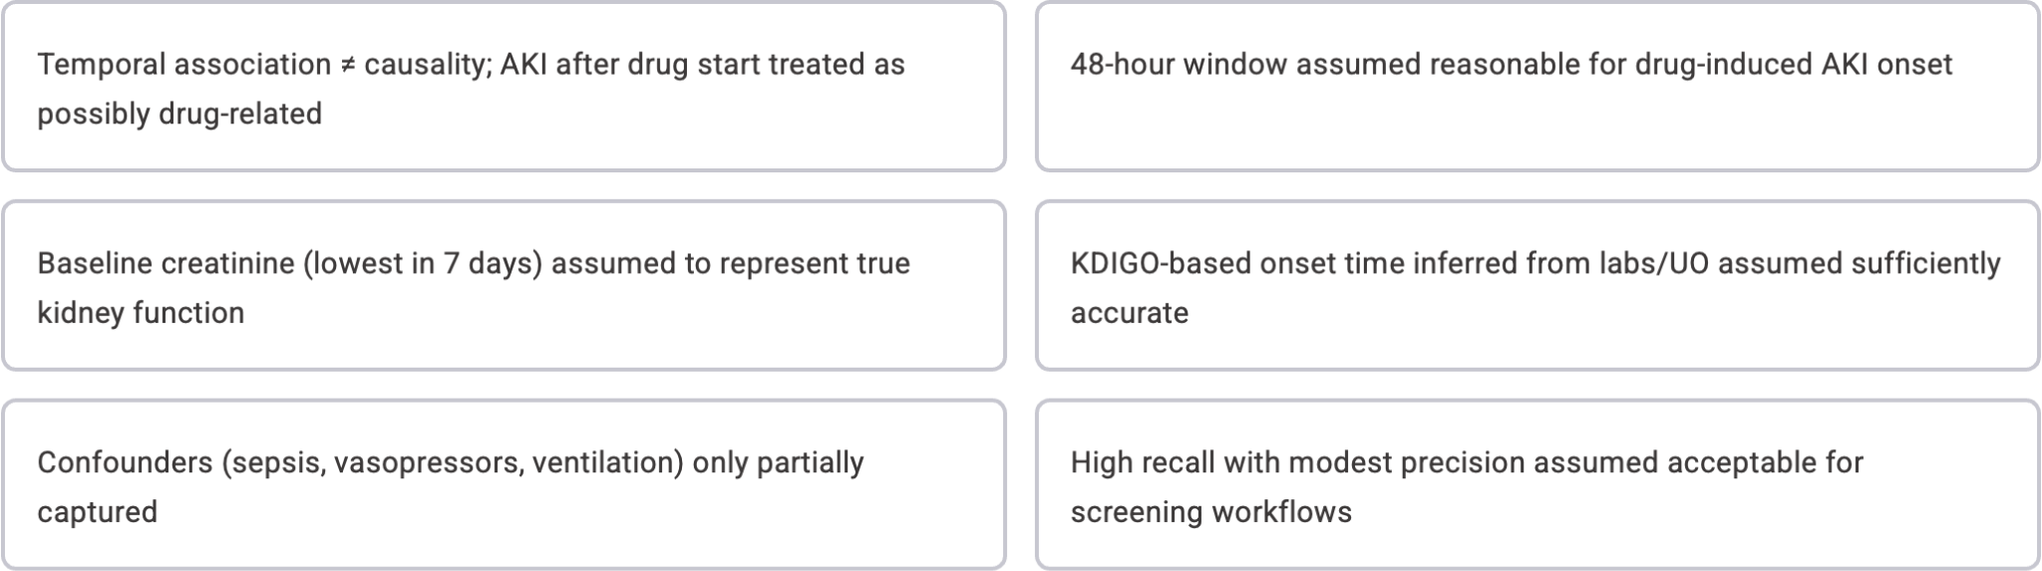
Key Considerations
Notes:
“In this project, we defined drug-associated AKI as events occurring within 48 hours of starting a nephrotoxic medication. We derived baseline creatinine using the lowest value in the prior 7 days and accounted for major confounders like sepsis and vasopressor use. However, we acknowledge that AKI causation is complex and not always directly attributable to the drug.

Slide 8
Our Approach: A Four-Part Solution
1
2
SQL-Defined ETL Pipeline
Supervised Learning Tasks
Built a fully SQL-based BigQuery pipeline on MIMIC-IV v3.1 to generate KDIGO AKI labels and drug-level ADE outcomes.
Designed two prediction tasks—48-hour drug-associated AKI and a broader “any post-drug AKI” outcome.
3
4
Feature Comparison
Clinical Interpretation
Tested baseline vs. temporally enriched models using rolling labs, vitals, urine output, severity scores, and key clinical interactions.
Assessed models with PR-AUC and threshold metrics, and used SHAP for clinically meaningful explanations.
Notes:
Our workflow includes four main steps:
First, we built a fully reproducible SQL-based pipeline in BigQuery.
Second, we created two supervised learning tasks — predicting AKI in 48 hours and predicting any post-drug AKI.
Third, we compared baseline versus temporally enriched feature sets.
And finally, we used SHAP analysis to ensure the results remain explainable to clinicians.”

Slide 9

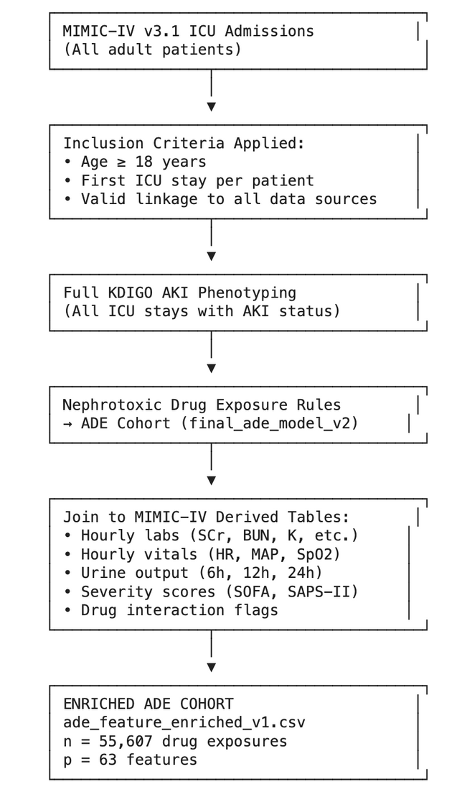
Data Source and Cohort Construction
MIMIC-IV v3.1 on BigQuery
Adult ICU Cohort
All analysis used MIMIC-IV v3.1 on Google BigQuery, pulling from core hospital tables and ICU tables..
We constructed an adult ICU cohort including all ICU stays for patients >=18 years at ICU admission. For patients with multiple stays, we kept only the first ICU stay
All transformations were implemented using SQL views/CREATE OR REPLACE TABLE for fully reproducible pipelines.
Final cohort: 65,366 unique ICU stays
Notes:
We used MIMIC-IV v3.1 on BigQuery and limited the dataset to adult patients at their first ICU stay to avoid repeated bias. After applying all inclusion and timing rules, we ended up with a final cohort of 65,000 ICU stays.”

Slide 10
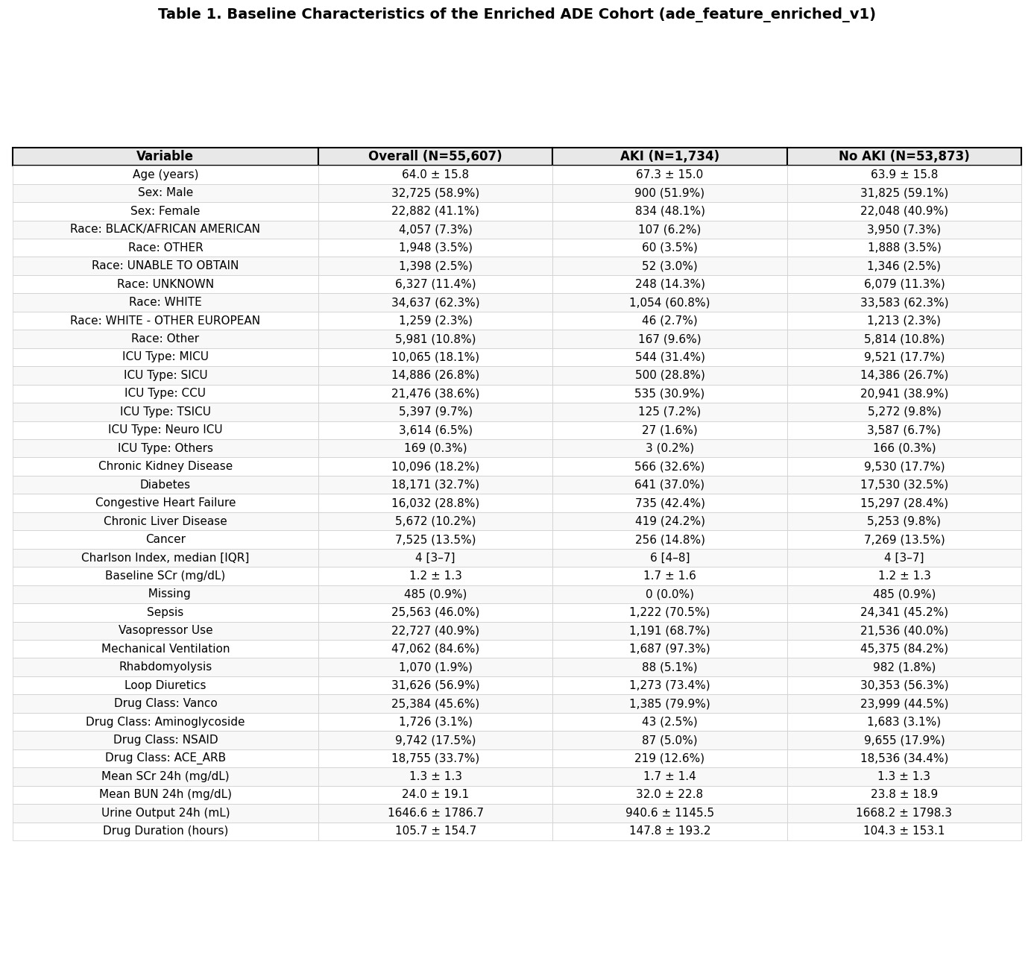
Table 1. Baseline Characteristics of the Enriched ADE Cohort
Notes:
“Here, we observe expected population patterns — for example, chronic kidney disease and cardiovascular comorbidities are more common among patients who developed AKI. This reinforces that our cohort reflects real clinical risk factors.”

Slide 11
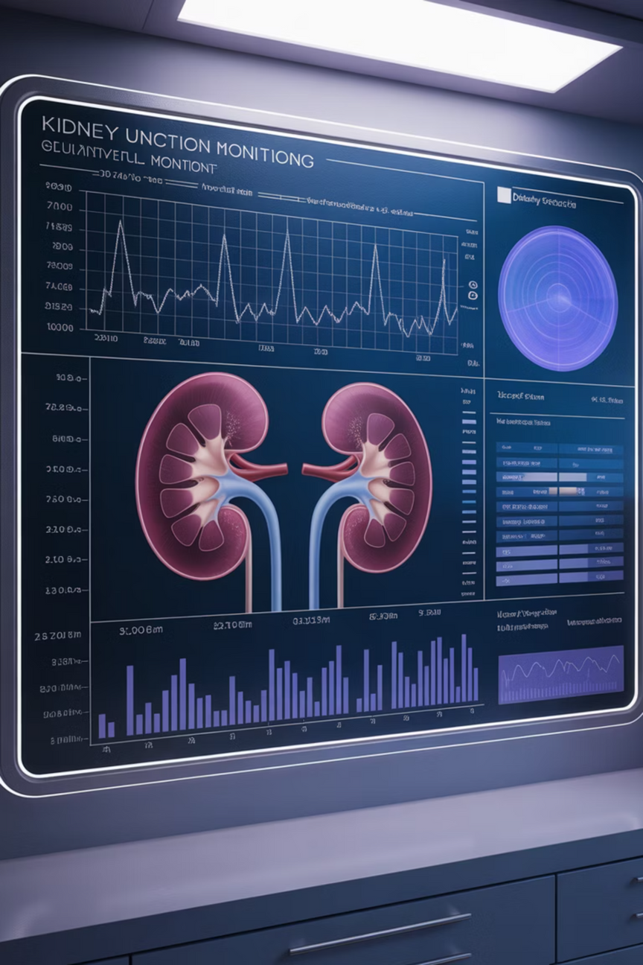



Defining AKI: Full KDIGO 2012 Criteria
We implemented comprehensive AKI detection using both serum creatinine (SCr) and urine output (UO) criteria, following KDIGO 2012 guidelines.
Baseline SCr
Lowest SCr in 7 days prior to ICU admission, or first SCr during hospitalization if unavailable.
SCr-Based AKI
Increase ≥0.3 mg/dL within 48 hours, ≥1.5× baseline, ≥2× baseline, or absolute SCr ≥4 mg/dL.
UO-Based AKI
Urine output <0.5 mL/kg/hr for ≥6 or ≥12 hours, <0.3 mL/kg/hr for ≥24 hours, or anuria for ≥12 hours.
Notes:
“We implemented the full KDIGO 2012 definition of AKI using both creatinine and urine output trends, which allowed us to detect AKI earlier and more accurately than studies that depend on creatinine alone.
Now we’ll move on to how we modeled drug exposures and engineered features for prediction..”

Slide 12
Nephrotoxic Drug Exposures
We focused on five nephrotoxic drug classes, using prescriptions and ICU timing to define exposures spanning ICU stay ±1 day.
25,384
27,897
18,755
9,742
Vancomycin
Loop Diuretics
ACE/ARBs
NSAIDs
Most common nephrotoxic antibiotic exposure
Highest overall exposure count
Common cardiovascular medications
Frequently used analgesics
1,726
Aminoglycosides
Potent but nephrotoxic antibiotics
Notes:
Slide 11 — Nephrotoxic Drug Exposures
“We focused on five nephrotoxic drug classes including vancomycin, loop diuretics, ACE/ARBs, NSAIDs, and aminoglycosides. These are common in critical care and carry significant AKI risk.”

Slide 13
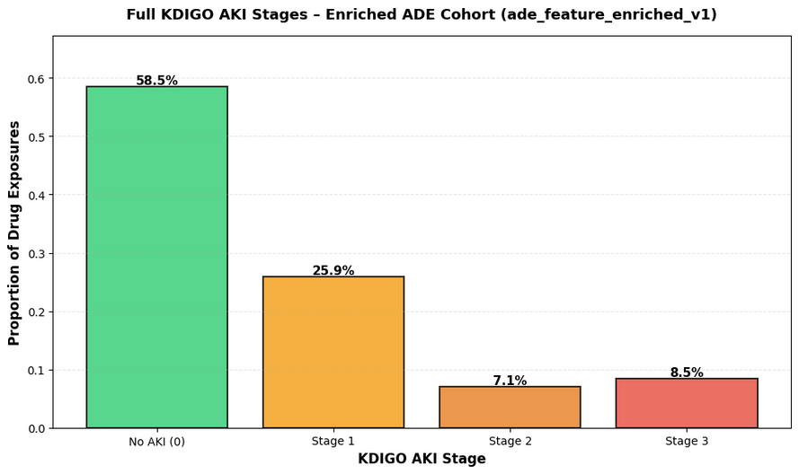
AKI Prevalence in Nephrotoxic Drugs-Exposed Cohort
Notes:
Slide 12 — AKI Prevalence
“Across all nephrotoxic exposures, around 40% developed some AKI stage. Nearly 16% reached Stage 2 or 3 — representing severe kidney damage.”

Slide 14
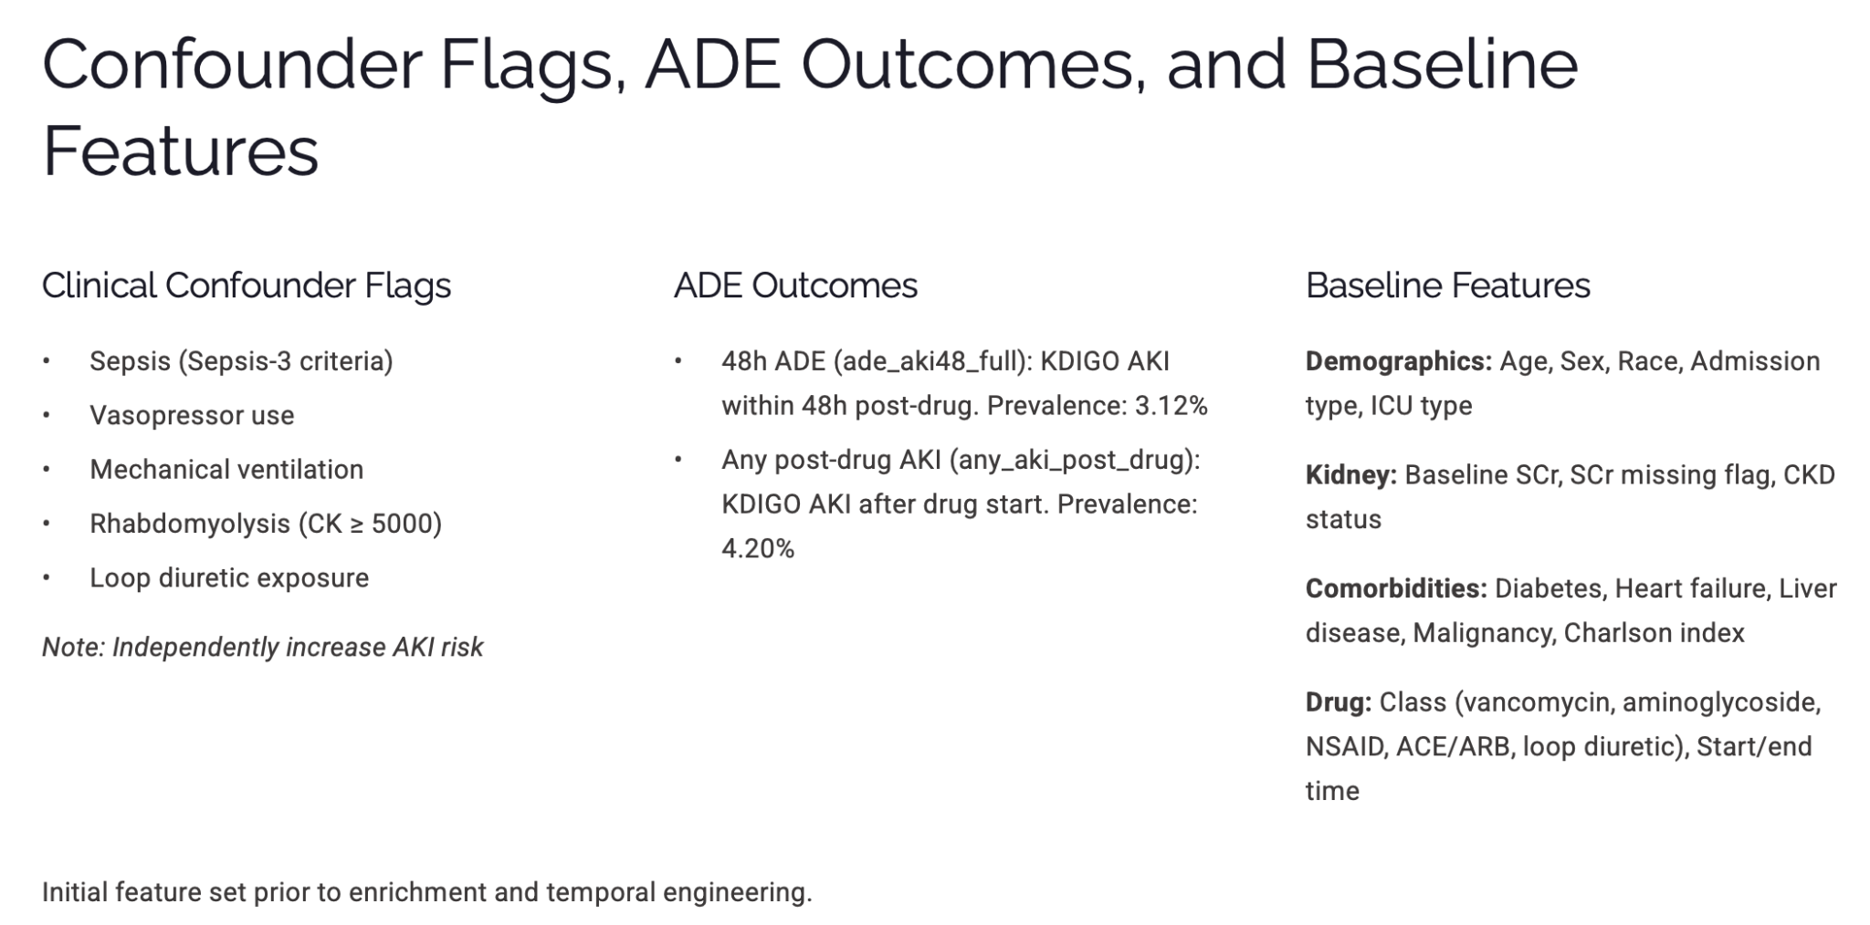
Notes:
Slide 13 — Confounders + Outcomes + Baseline Features
“We included flags like sepsis and vasopressor use — conditions that independently raise AKI risk.
Two outcomes:
• 48-hour drug-associated AKI
• Any post-drug AKI during ICU stay”
48-hour drug-associated AKI: Kidney injury that occurs within 48 hours after a nephrotoxic drug is given — likely linked to the medication.
Any post-drug AKI: Kidney injury that happens any time after the drug is administered during the ICU stay, regardless of timing.

Slide 15

Feature Engineering: Baseline vs Enriched
Baseline Features
Demographics & context (age, sex, race, admisssion type, ICU unit)
Baseline kidney status(SCr, CKD indicator)
Comorbidities (diabetes, HF, liver disease, cancer, Charlson index)
Cofounders at drug start(sepsis, vasopressors, ventilation, rhabdomyolysis, loop exposure)
Drug class + timing
Temporally Enriched Features
Rolling labs (24h pre-drug): SCr, BUN, electrolytes, bicarbonate
ICU vitals: HR, MAP, SpO2
Urine output: 6h, 12h, 24h volumes
Drug duration
Severity scores(SOFA, SAPS II)
Interaction features (e.g., CKD+vancomycin, diabetes+NSAID)
Notes:
Slide 14 — Feature Engineering
“We compared:
• Simple baseline clinical features vs.
• Temporally enriched features capturing trends, drug timing, and severity
This allowed our models to better recognize clinical deterioration before AKI happens.”
🔁 Transition: “Now I’ll hand it over to explain how we modeled and evaluated risk.”

Slide 16
Model Training Approach
For each outcome, we trained two CatBoost classifiers using the same train/test split (80/20) with stratification by outcome.
1
2
Class Weighting
Hyperparameters
Applied inverse prevalence weights to address severe imbalance (31:1 for 48h AKI, 23:1 for any AKI).
Logistic loss, depth 6, 2000 max iterations with early stopping after 50 rounds of non-improving validation AUC.
3
4
Threshold Selection
Interpretation
Swept thresholds 0.05-0.50, identified F1-maximizing threshold, fixed at 0.50 for primary reporting.
Computed SHAP values on test data to quantify feature contributions and align with clinical intuition.
Notes:
Here’s how we trained our enriched CatBoost models for AKI prediction.
Next, we hyperparameterized - tuned Catboost model. For thresholding, instead of relying on the default 0.5, we swept thresholds from 0.05 to 0.50 to find the F1-maximizing point—important when positive cases are so rare. Finally, we used SHAP to interpret the contribution of every feature and to confirm the model aligns with clinical intuition.”

Slide 17
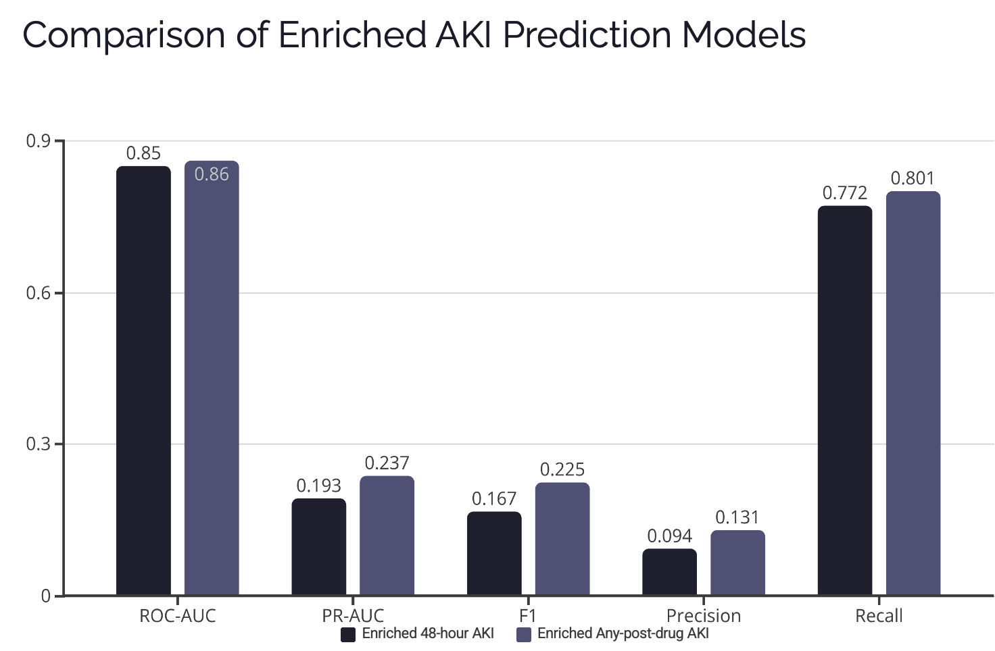
Notes:
“Here we compare the enriched 48-hour AKI model against the enriched any-post-drug AKI model. Both models achieve strong ROC-AUC—around 0.85 to 0.86—meaning they separate cases from non-cases very well. But the Post-drug AKI model consistently outperforms the 48-hour model on PR-AUC, F1, precision, and recall. This suggests that the enriched feature set is particularly powerful when predicting AKI risk over the entire drug exposure window, not just 48 hours

Slide 18
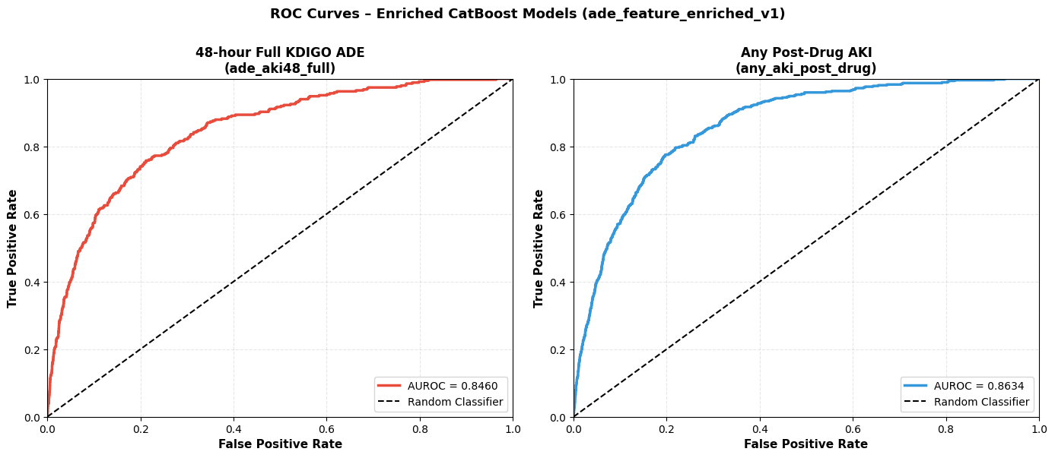
Notes:
These ROC curves reinforce that both models have strong discriminative ability. The area under the curve is 0.846 for 48-hour AKI and 0.863 for any post-drug AKI. The post-drug model performs slightly better, likely because it has more positive examples and a broader time window to detect meaningful signal.”

Slide 19
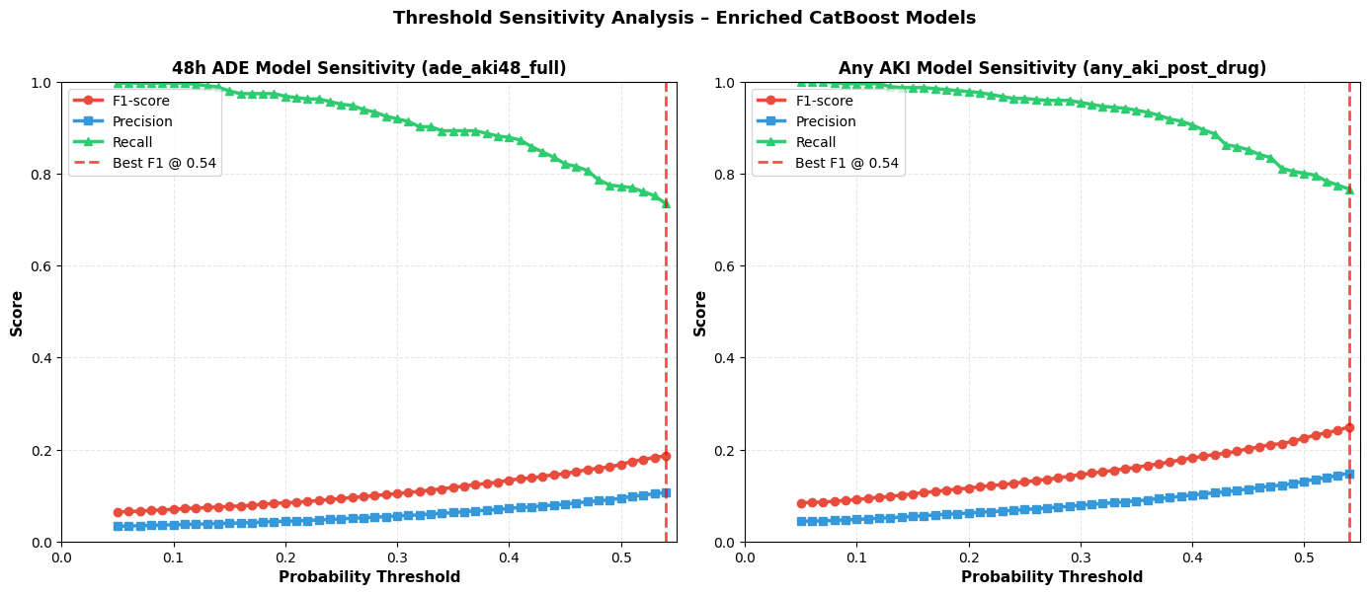
Threshold Sensitivity Analysis
Notes:
“This slide shows how precision, recall, and F1 behave as we vary the decision threshold. Across both models, recall stays very high at lower thresholds but decreases as we move toward 0.5. The best F1 for both models occurs around a threshold of 0.54, balancing precision and recall. This is critical for clinical deployment—hospitals may prioritize higher recall to avoid missing AKI cases, even at the cost of some false positives.”

Slide 20
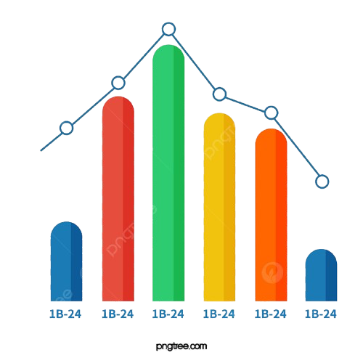
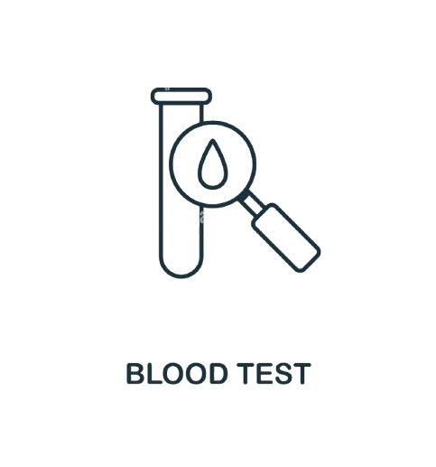
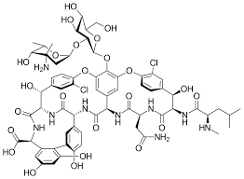
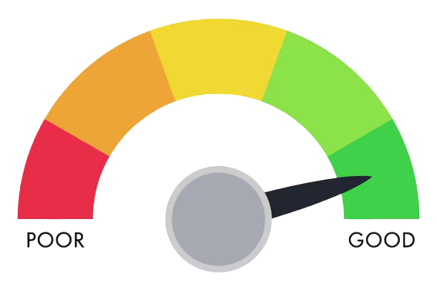
What Drives AKI Risk? SHAP Analysis
SHAP analysis revealed the most important features for predicting drug-associated AKI, aligning with clinical expectations.
Vancomycin Exposure
SAPS II Severity Score
Loop Diuretic Exposure
Baseline Serum Creatinine
Strongest predictor of 48-hour AKI.
SHAP shows high positive contribution → risk sharply increases when vancomycin is used.
Reflects known nephrotoxicity and dose-related toxicity in critically ill patients.
⁠Higher severity scores greatly increase AKI risk.
Captures global physiologic instability → sicker patients are more vulnerable to kidney injury.
⁠SHAP confirms a *monotonic risk gradient* with rising severity.
More loop diuretic orders → fluid depletion + hemodynamic stress → increased AKI risk.
SHAP indicates even modest diuretic exposure contributes meaningfully to model predictions.
Elevated baseline SCr = reduced kidney reserve.
SHAP shows higher SCr consistently pushes prediction toward AKI.
Clinically consistent: chronic impairment = higher susceptibility.
Notes:
“SHAP lets us open the black box and see what features drive AKI predictions. Across both models, the top predictors are clinically intuitive:
Vancomycin exposure — the strongest contributor; SHAP shows AKI risk sharply increases when patients receive vancomycin.
SAPS II severity score — powerful signal of physiologic instability; sicker patients are much more vulnerable.
Loop diuretic exposure — more diuretic orders correlate with fluid depletion and hemodynamic stress, both risk factors for AKI.
Baseline serum creatinine — higher baseline SCr reflects reduced kidney reserve, consistently increasing predicted risk.
These findings match well-known nephrology patterns and validate that the model is learning meaningful clinical relationships.”
🔁 Transition: Now that we’ve seen what the model learns and how well it performs, we’ll discuss how this can be applied in real clinical workflows and where future improvements are needed.

Slide 21




Why Temporal Enrichment Matters
Static baseline features are not enough. The largest gains came from features that capture dynamic clinical trajectories and encode the signals clinicians reason about informally.
Overall Severity
Trajectory of Kidney Function
SOFA and SAPS II scores captured organ dysfunction and illness acuity comprehensively.
SCr trends and low urine output revealed declining renal function before AKI onset.
Clinical Interactions
Intensity of Exposure
Diabetes+NSAID and CKD+vancomycin flags marked high-risk combinations explicitly.
Loop diuretic order counts and drug duration quantified cumulative nephrotoxic burden.
Encoding these signals explicitly allowed CatBoost to better separate high- and low-risk exposures, especially under severe class imbalance.
Notes:
Slide 20 — Why Temporal Enrichment Matters
One of our main findings is that temporal enrichment is essential. Single snapshots can’t show how a patient is changing, but trends in serum creatinine, urine output, severity scores, and drug burden reveal early signs of deterioration. These temporal signals give a much more realistic, real-time view of AKI risk and allow for earlier detection.

Slide 22
Clinical Application: Workflow
The any-AKI-post-drug model is better suited for deployment than the 48-hour model and supports a realistic screening workflow.
Daily Screening
Clinical Review
Run the model once per day for patients receiving nephrotoxic drugs in the ICU.
Pharmacists or nephrologists review flagged cases, considering dose adjustment or alternative agents.
1
2
3
4
Risk Flagging
Enhanced Monitoring
At threshold 0.5, identify a subset of patients at elevated risk (recall 0.80, precision 0.13).
Implement closer monitoring with more frequent SCr checks or urine output tracking.
Notes:
Slide 21 — Clinical Workflow
“Our recommended workflow:
1️⃣ Daily risk scoring
2️⃣ High-risk flags
3️⃣ Pharmacist/nephrologist review
4️⃣ Closer monitoring or drug adjustments
This can fit directly into ICU stewardship programs.”To put this into practice, we propose a straightforward clinical workflow: generate daily risk scores, trigger high-risk flags when thresholds are exceeded, and have a pharmacist or nephrologist review those cases to adjust medications or monitoring as needed. This integrates smoothly into existing ICU stewardship programs.

Slide 23
Limitations and Future Directions
Current Limitations
Future Work
Single-center dataset: MIMIC-IV reflects one academic medical center; external validation needed
  External validation on other EHR datasets and institutions
  Model calibration and monitoring for drift over time
Temporal association ≠ causation: Some events may be due to underlying illness rather than drugs
  Integration with clinician-facing interfaces that surface SHAP-highlighted features
Residual confounding: Unmeasured confounders remain despite extensive adjustment
Modest precision: ~0.13 at reasonable recall limits suitability for hard-stop alerts
Notes:
Slide 22 — Limitations & Future Work
“We need external validation beyond MIMIC-IV. Causality is still uncertain — AKI could be from illness, not drug. Improving precision and real-world testing are key next steps.”We also recognize limitations: we need external validation beyond MIMIC-IV, and AKI risk may reflect underlying illness rather than drug exposure. Improving precision and testing the model in real clinical settings are important next steps.

Slide 24
Conclusion: Toward Safer Medication Use in the ICU
We built and documented a BigQuery pipeline on MIMIC-IV v3.1 that generates full KDIGO AKI labels and drug-level ADE outcomes. Temporally enriched CatBoost models substantially improved PR-AUC and recall for predicting drug-associated AKI.
Temporal Context is Crucial
Temporal Context is Crucial
Decision Support, Not Replacement
Pre-drug rolling labs, vitals, urine output, severity scores, and interaction flags were essential for identifying at-risk patients.
Models should support clinician judgment by surfacing risk scores and interpretable drivers, not make autonomous decisions.
Notes:
Slide 23 — Conclusion
“We successfully built a fully reproducible KDIGO pipeline and predictive model. Temporal features were crucial, and our system can support clinicians in preventing avoidable kidney injury.” In summary, we created a fully reproducible KDIGO pipeline and predictive model where temporal features played a crucial role, and the system shows strong potential to help clinicians prevent avoidable kidney injury.

Slide 25
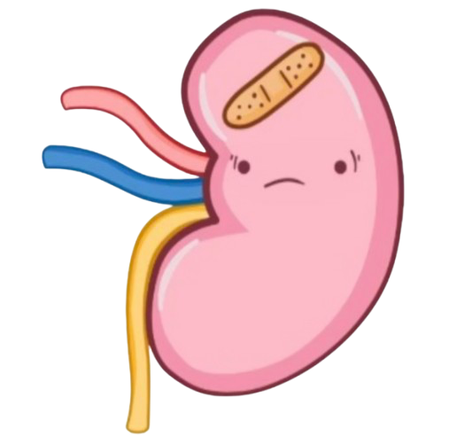
THANK YOU!
Questions?

